Slide 1
Priority Queue Sorting
9.4

Slide 2
Heap-Sort
9.4.2

Slide 3
Heap-Sort
Consider a priority queue with n items implemented by means of a heap
the space used is O(n)
methods add and remove take O(log n) time
methods size and isEmpty take time O(1) time

Slide 4
Heap-Sort
Using a heap-based priority queue, we can sort a sequence of n elements in O(n log n) time
The resulting algorithm is called heap-sort
Heap-sort is much faster than quadratic sorting algorithms, such as insertion-sort and selection-sort

Slide 5
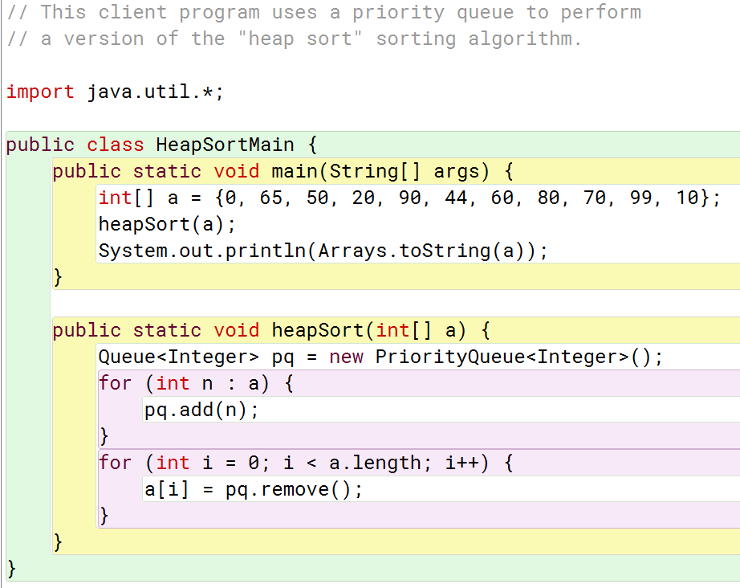
Heap Sort Example

Slide 6
Selection-Sort and Insertion-Sort
9.4.1

Slide 7
Priority Queue Sorting
We can use a priority queue to sort a list of comparable elements
Insert the elements one by one with a series of add operations
Remove the elements in sorted order with a series of remove operations
The running time of this sorting method depends on the priority queue implementation

Slide 8
Selection-Sort
Selection-sort is the variation of PQ-sort where the priority queue is implemented with an unsorted sequence
Running time of Selection-sort:
Inserting the elements into the priority queue with n add operations takes O(n) time
Removing the elements in sorted order from the priority queue with n remove operations takes time proportional to 1 + 2 + …+ n
Selection-sort runs in O(n²) time

Slide 9
Selection-Sort Example
Sequence S Priority Queue P
Input: (7,4,8,2,5,3,9) ()
Phase 1
(a) (4,8,2,5,3,9) (7)
(b) (8,2,5,3,9) (7,4)
.. .. ..
(g) () (7,4,8,2,5,3,9)
Phase 2
(a) (2) (7,4,8,5,3,9)
(b) (2,3) (7,4,8,5,9)
(c) (2,3,4) (7,8,5,9)
(d) (2,3,4,5) (7,8,9)
(e) (2,3,4,5,7) (8,9)
(f) (2,3,4,5,7,8) (9)
(g) (2,3,4,5,7,8,9) ()

Slide 10
Insertion-Sort
Insertion-sort is the variation of PQ-sort where the priority queue is implemented with a sorted sequence
Running time of Insertion-sort:
Inserting the elements into the priority queue with n add operations takes time proportional to
1 + 2 + …+ n
Removing the elements in sorted order from the priority queue with a series of n remove operations takes O(n) time
Insertion-sort runs in O(n²) time

Slide 11
Insertion-Sort Example
Sequence S Priority queue P
Input: (7,4,8,2,5,3,9) ()
Phase 1
(a) (4,8,2,5,3,9) (7)
(b) (8,2,5,3,9) (4,7)
(c) (2,5,3,9) (4,7,8)
(d) (5,3,9) (2,4,7,8)
(e) (3,9) (2,4,5,7,8)
(f) (9) (2,3,4,5,7,8)
(g) () (2,3,4,5,7,8,9)
Phase 2
(a) (2) (3,4,5,7,8,9)
(b) (2,3) (4,5,7,8,9)
.. .. ..
(g) (2,3,4,5,7,8,9) ()

